Slide 1

Baptist Health DevOps Terraform Workshop
Day 3 – Introduction to DevOps, VS Code and Terraform

Slide 2

Hello!
Jordan Baldridge
Senior Software Engineer, Insight

Slide 3
This Week’s Schedule
Day 1 – Introduction to DevOps, VS Code and Terraform
Day 2 – Introduction to GitHub & Terraform Cloud
Day 3 – Labs, Advanced Terraform and BHS Terraform

Slide 4
Lab 1: Azure Initial setup
Create a Free Azure Account
https://azure.microsoft.com/en-us/free/
Create a Service Principal (SPN) for Automation

Slide 5
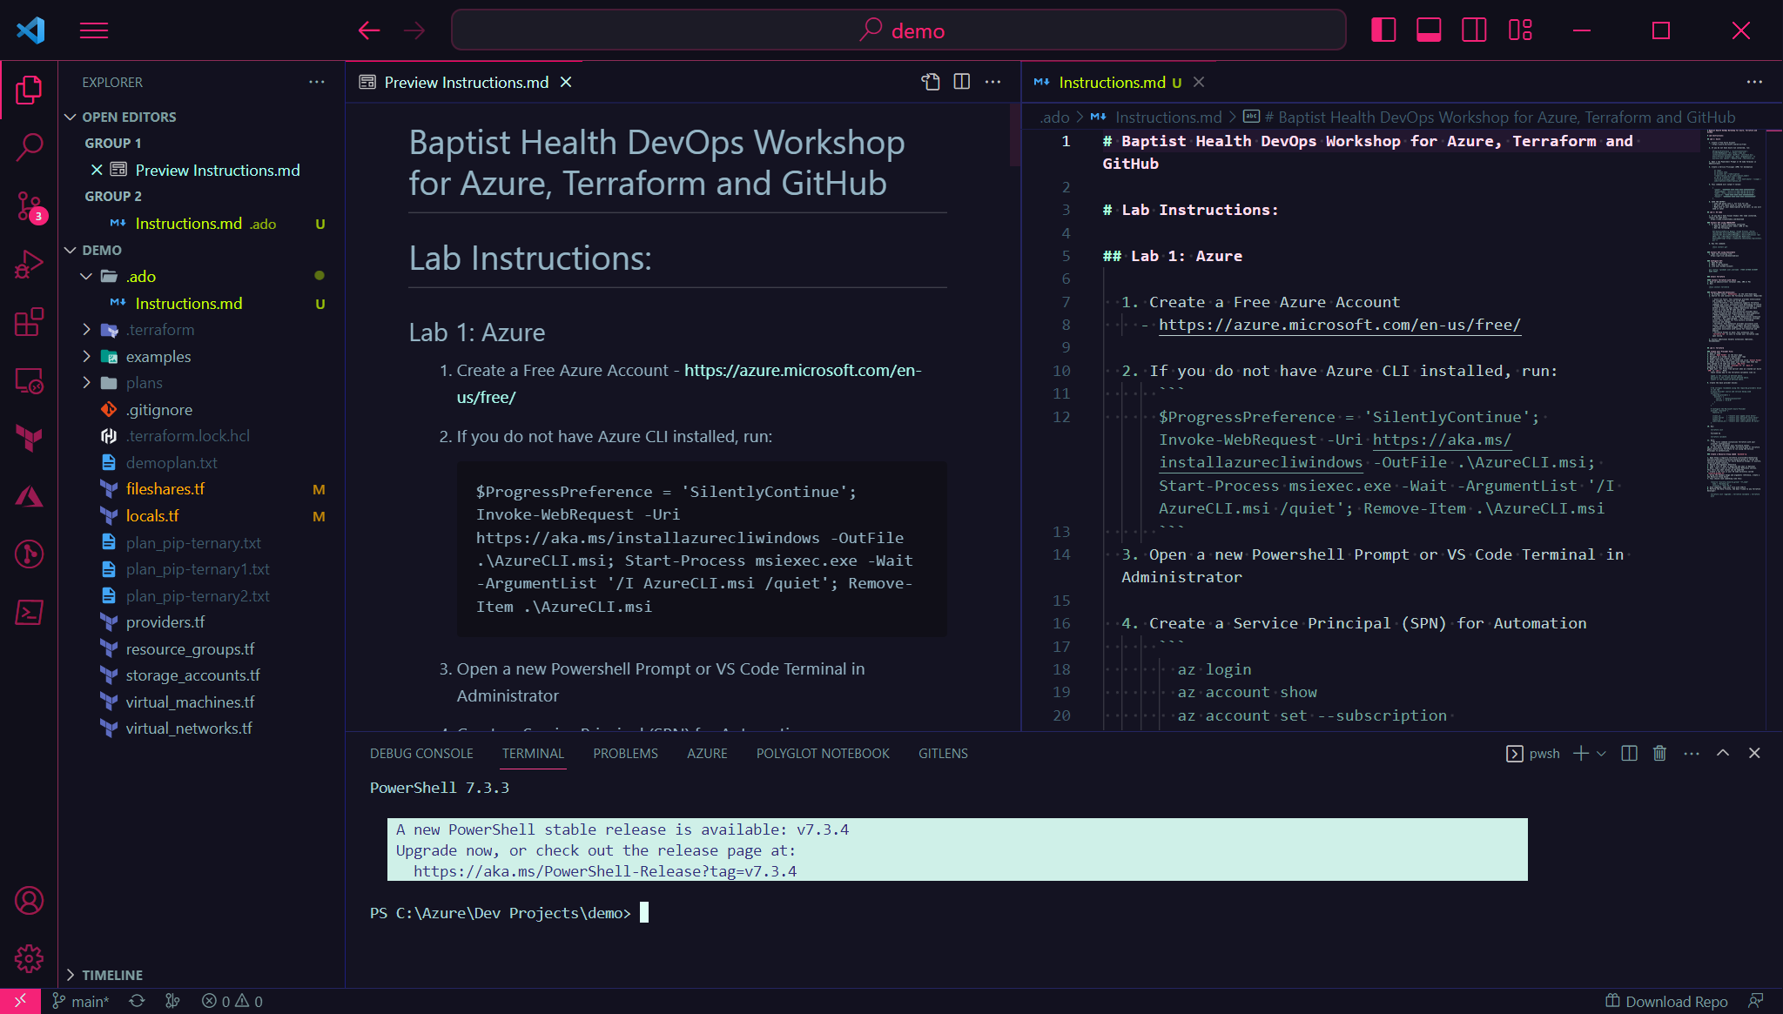
VS Code

Slide 6
Lab Time! Create a Provider File
Labs are located in a Repo at: https://github.com/devops-workshops-bhs/devops-workshop/blob/main/Day1/Day1_Labs.md
We encourage collaboration during the labs – if you run into an issue or error, please be prepared to share your screen so we can all collaborate (and learn)!

Slide 7

Getting Started with Azure Provider
Lab Time: 30 minutes

Slide 8
Terraform Workflow
post-lab review

Slide 9
Terraform and Provider Versions

Slide 10
Terraform and Provider Versions
post-lab review

Slide 11
Plan Output Binary
Demo

Slide 12
Plan Output Binary
post-lab review

Slide 13
Questions
What happens when you try to apply a “stale” plan that was output with “-out”?
How does the “-out” parameter simplify variable inputs?
How could plan outputs be useful?

Slide 14
A “Real” Deployment

Slide 15
A “Real” Deployment
post-lab review

Slide 16
GitHub Overview
Are you one of the 65+ million GitHub users?

Slide 17
GitHub Lab
Getting Started in GitHub

Slide 18
Terraform Cloud Lab
Tying it all together!

